Slide 1
Hardware Hacking through UART
With Samuel Kamas

Slide 2
Why Hack Hardware?
Hardware is hard to update - any vulnerabilities aren’t going to get patched anytime soon
Hardware hacking can uncover trade secrets, intellectual property and even customer data
The firmware stored within the device in particular can contain particularly sensitive information such as encryption keys and API keys
We can make our own modifications to the target device (for better or worse!)

Slide 3
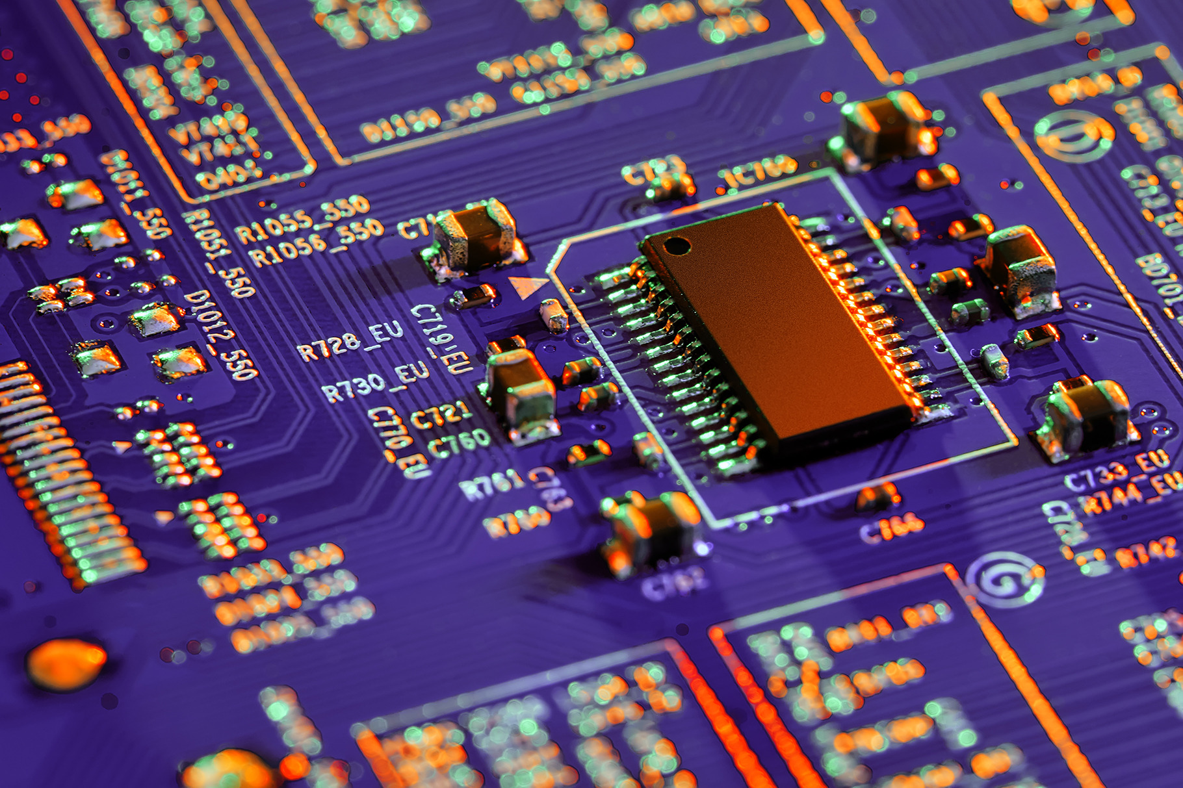
Introduction to UART
UART (Universal Asynchronous Receiver Transmitter) is a protocol supported by many IoT devices.
UART is a debugging protocol used by developers to gain a shell into the firmware of the device they’re developing.
The UART ports on a board should be either disabled or removed after development… but that’s not always the case!

Slide 4
UART Identification
Half the battle with UART is actually finding it on a board
It resembles a rectangle of four ports neighbouring each other, similar to the given diagram
The ports may or may not be in the order shown
VCC
Power
GND
Ground
TX
Transmit
RX
Receive

Slide 5
UART Classification
Power (VCC) is the port used to provide power to the module
Ground (GND) is the module’s electrical grounding
Transmit (TX) is the port for transmitting information to the connected interface
Receive (RX) is the port for receiving information from the connected interface
VCC
Power
GND
Ground
TX
Transmit
RX
Receive

Slide 6
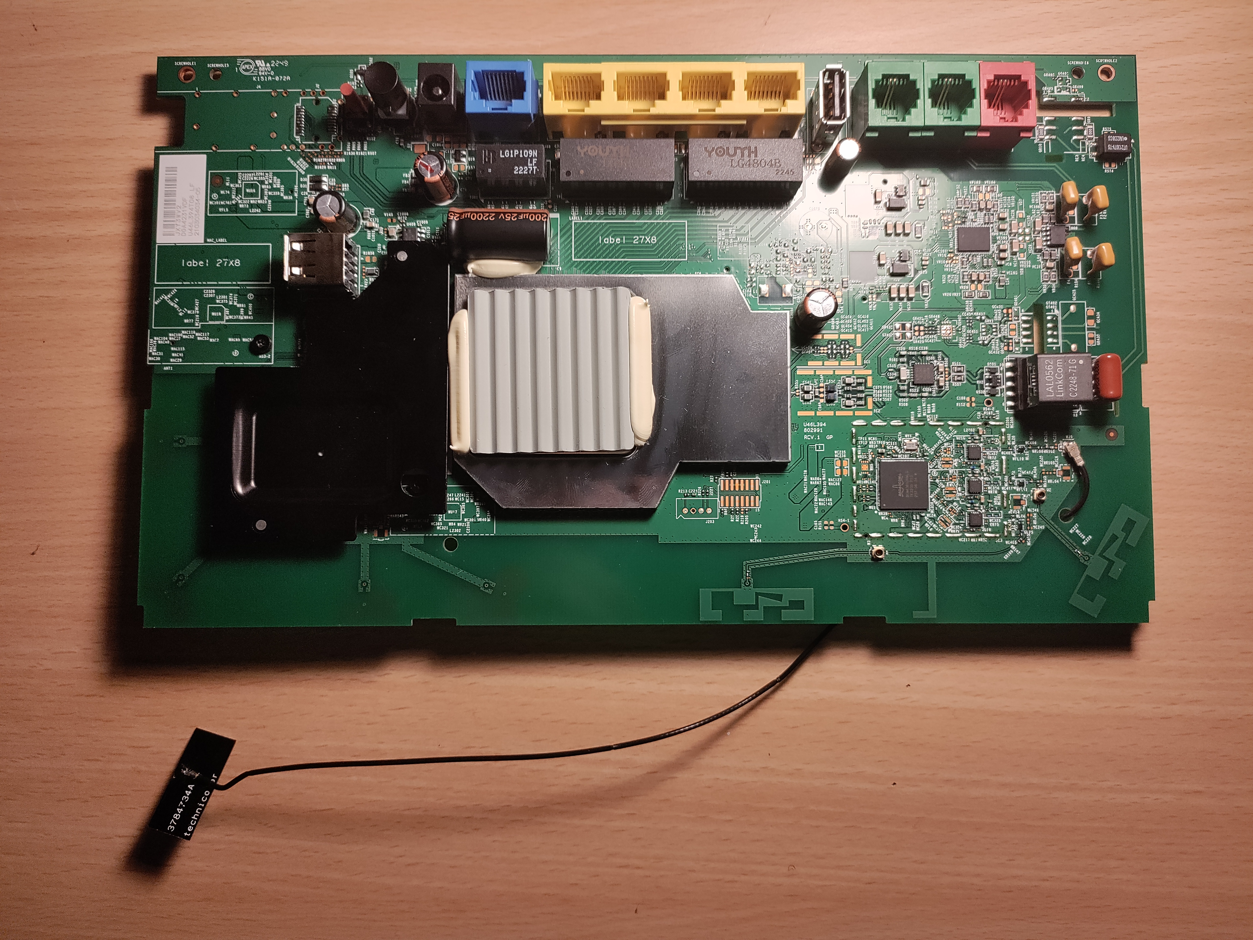
Exercise: Where is UART?

Slide 7
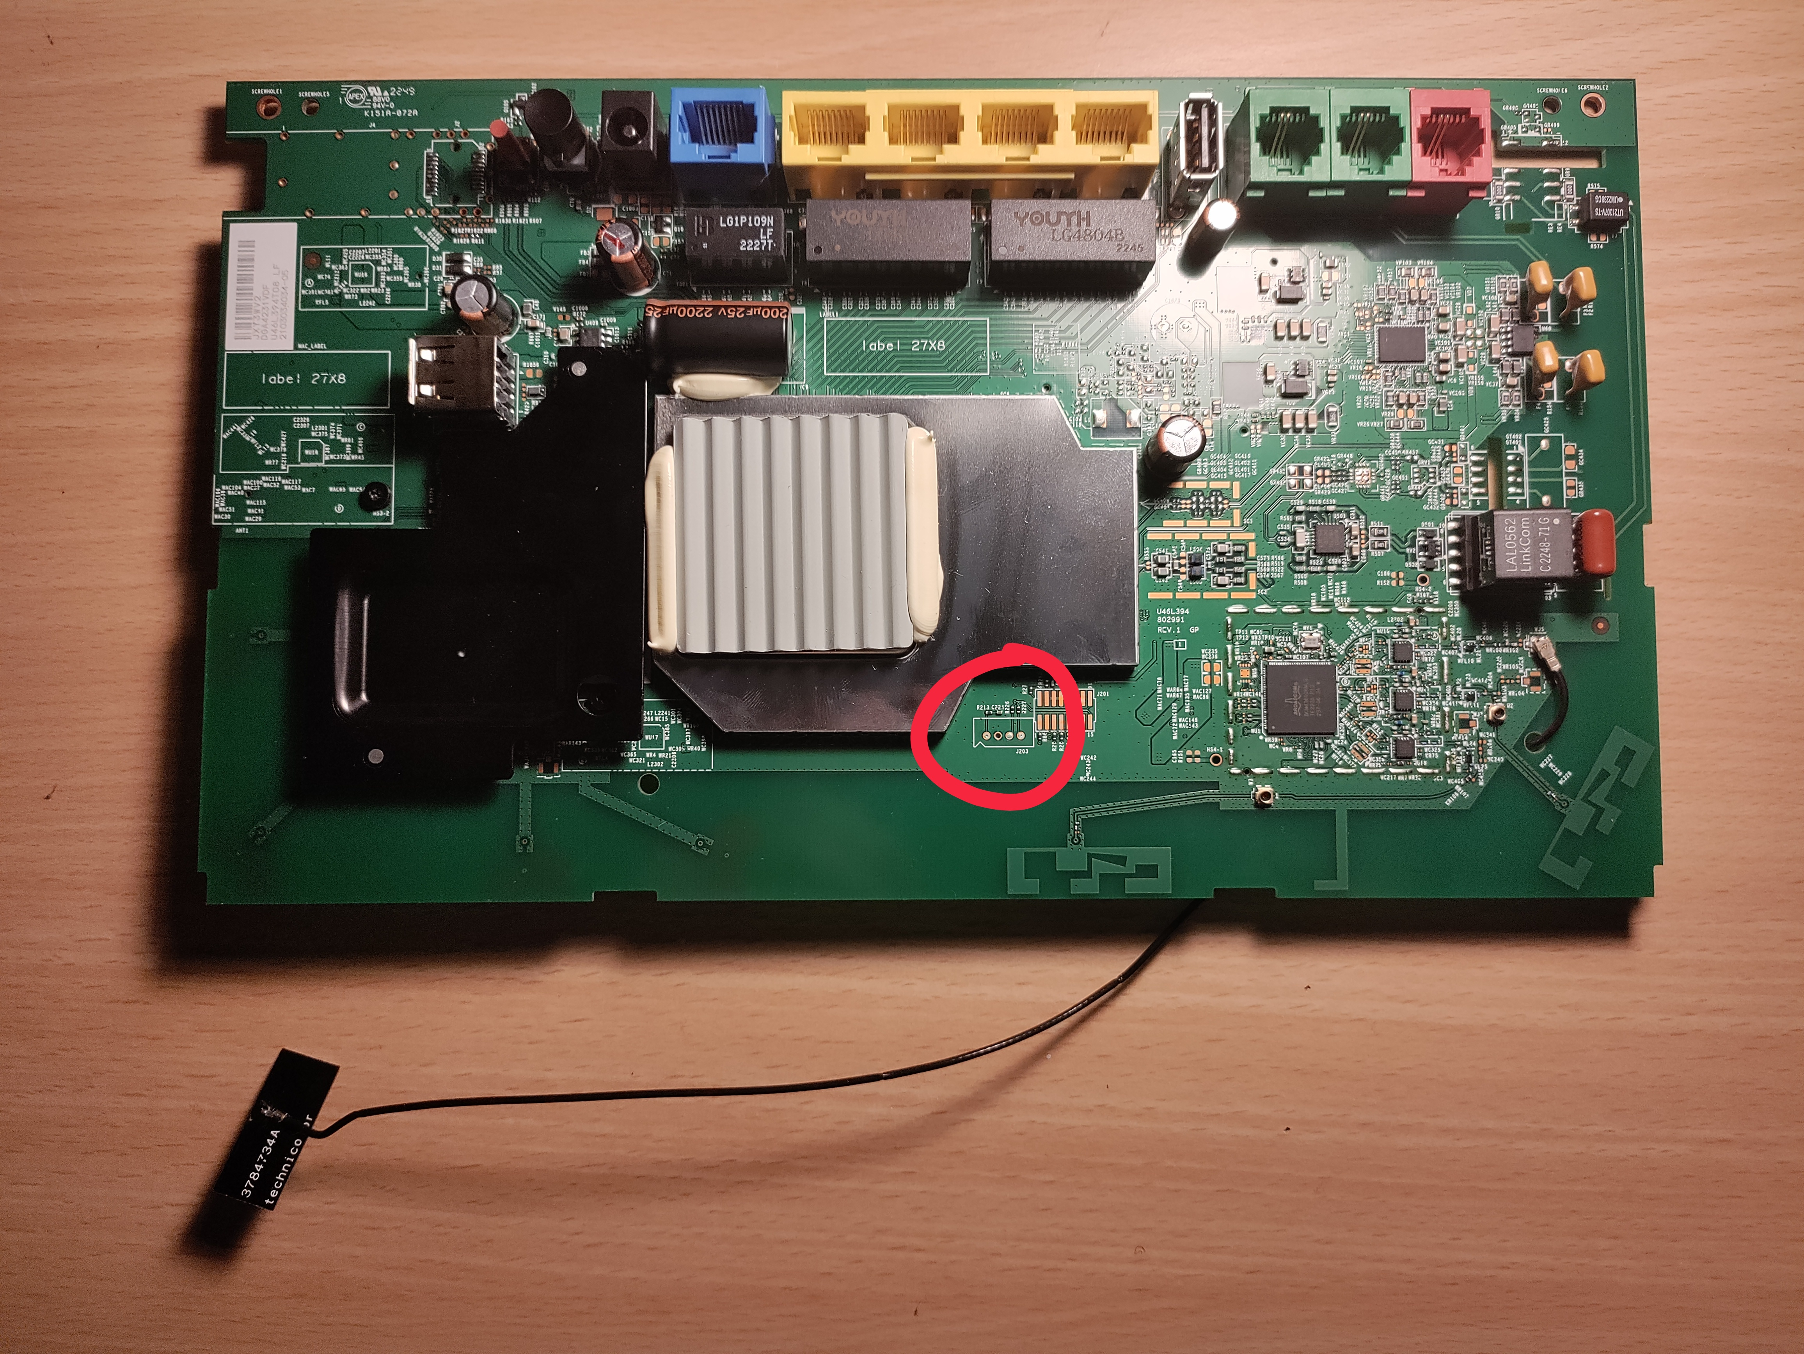
Here it is!

Slide 8
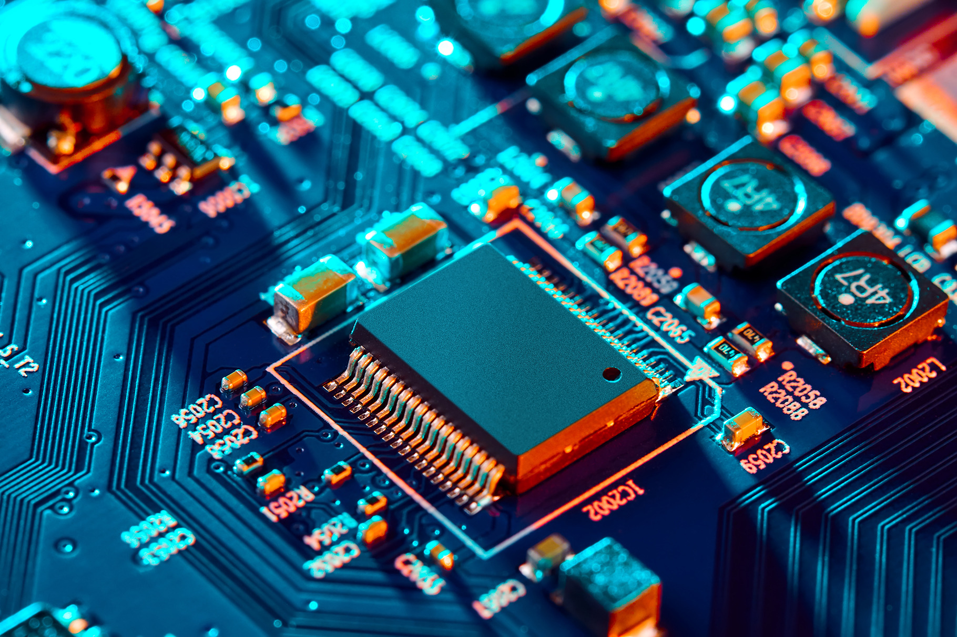
Labelling UART
As earlier stated, UART is not always in the orientation shown in earlier diagrams, so we’ll need to label each port before connecting to them
You will need a multimeter for this!
However, there is always the off-chance that UART has already been labelled for you!

Slide 9
Connecting to UART
Connecting to UART is relatively simple, the process is shown in the diagram below:
TX
TX
RX
RX
GND
GND

Slide 10
Interfacing with UART
Interfacing with UART is relatively simple
There is extra hardware needed – a UART bridge to connect your device with the target hardware
You will also need some sort of software to interpret the signals passed by the UART bridge
When initially connected, the output will probably just be total gibberish
The reason for this is the baud rate, which dictates the rate of information being transferred
In order to output legible text, you’d need to find and set the correct baud rate

Slide 11
You’re in!
Shell access is yours

Slide 12
Hardware Hacked
I hope you enjoyed the presentation
Thank you for your attention!
https://github.com/venatus9/Hardware-Hacking

